Slide 1
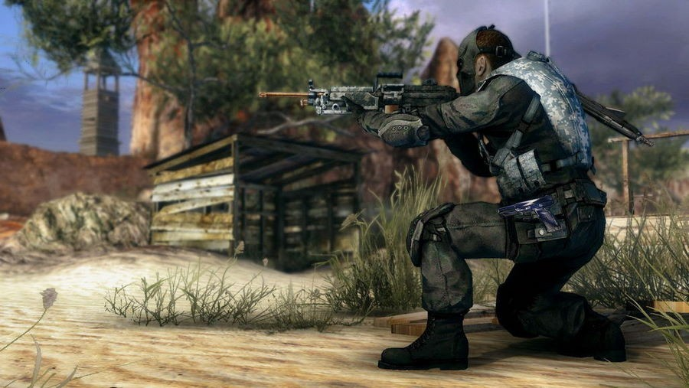
BattleZone

Slide 2
Concept
Vision: To create a 2D shooter game that is equivalent to Space Invader.
A single-player, 2D shooter game.
Play as a Soldier: One man betrayed by the country he loved must defend his country from invaders for as long as possible.

